Slide 1

Project Title –
Healthcare Analytics for Doctor Visits
NAME: Devansh Soni
AICTE ID: STU6a01840a64cfc1778484234

Slide 2

PROBLEM STATEMENT
People may visit doctors at different frequencies depending on their health conditions, illness, age, income, activity limitations, and chronic health conditions.
The objective of this project is to analyze the healthcare dataset and identify patterns associated with the number of doctor visits. The analysis will examine factors such as health condition, illness, socioeconomic background, healthcare support, and chronic conditions to understand how they relate to healthcare utilization.
The project aims to answer the key question: Why do some people visit a doctor more often than others?

Slide 3
Project Description:
Healthcare Analytics for Doctor Visits is a data analytics project focused on understanding patterns in healthcare utilization. The dataset contains 5,190 records and 13 columns, including age, gender, income, illness, health condition, reduced activity, healthcare support, and chronic conditions. The project analyzes these factors to identify patterns associated with the number of doctor visits. Data preprocessing, exploratory analysis, statistical methods, and visualizations are used to examine relationships within the dataset. The analysis aims to understand why some individuals visit doctors more often than others and provides a data-driven understanding of healthcare utilization patterns.

Slide 4

WHO ARE THE END USERS?
Healthcare Administrators – To understand patterns in doctor visits and healthcare utilization.
Doctors & Healthcare Professionals – To understand how health conditions and illnesses are associated with doctor visits.
Healthcare Organizations – To analyze healthcare usage patterns and support planning.
Researchers & Data Analysts – To study relationships between demographic, financial, and health-related factors.
Students & Academics – To learn and demonstrate how healthcare data can be analyzed using data analytics and visualization.

Slide 5

Technology Used
Python – Main programming language used for data analysis.
Pandas – Used for data loading, cleaning, manipulation, grouping, and statistical analysis.
NumPy – Used for numerical operations and data processing.
Matplotlib – Used to create data visualizations and charts.
Seaborn – Used for statistical visualizations such as bar plots, box plots, scatter plots, and heatmaps.
Jupyter Notebook – Used as the development environment for performing and documenting the analysis.
CSV Dataset – Used as the primary data source containing 5,190 healthcare records and 13 columns.

Slide 6
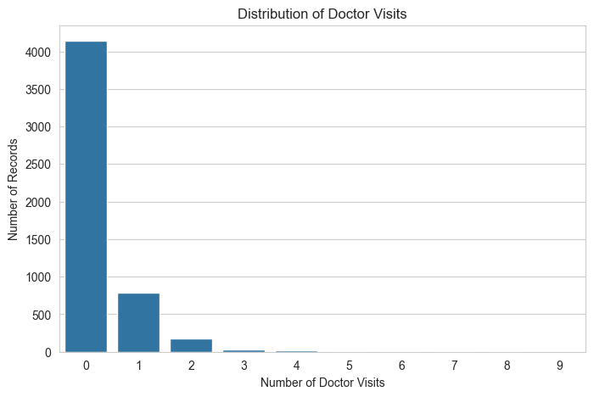
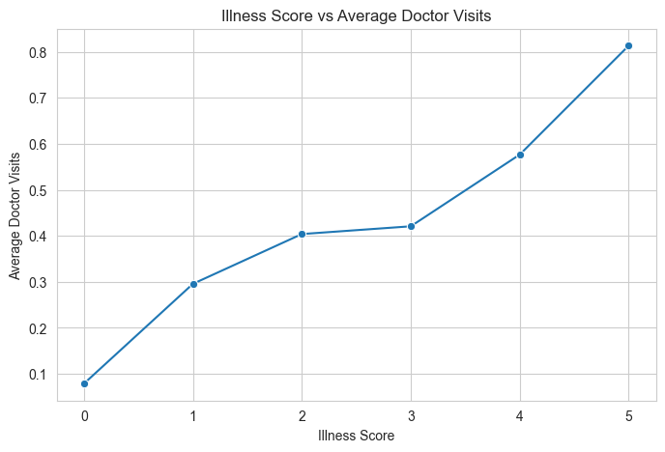
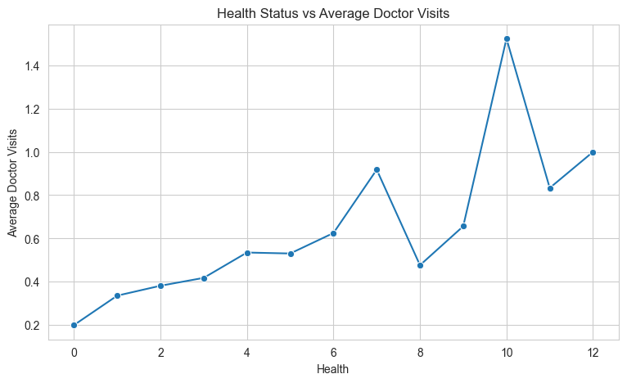
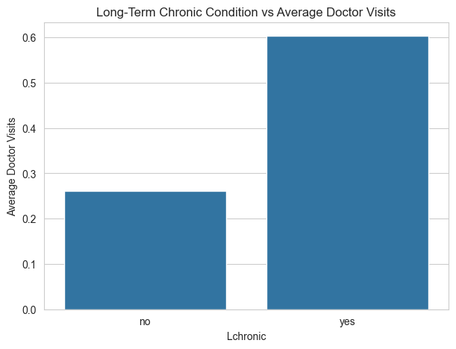
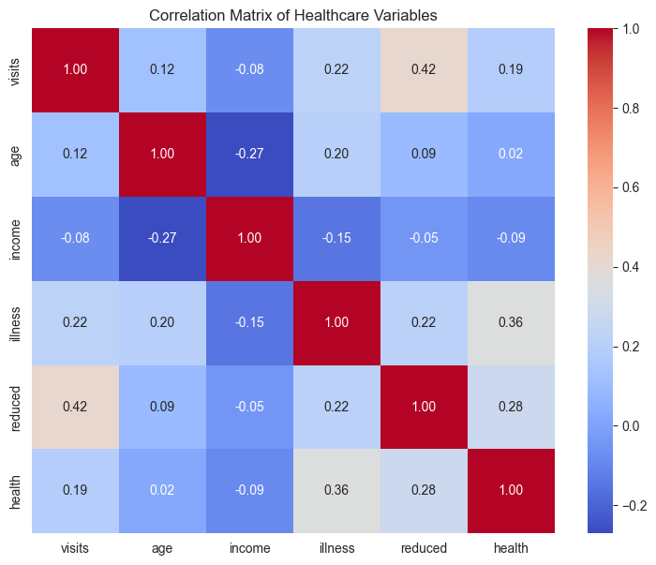
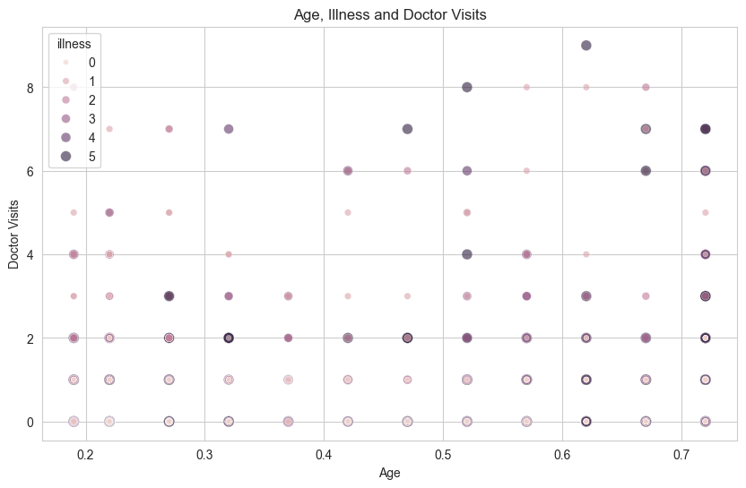
RESULTS

Slide 7
Thank you
GITHUB REPO LINK: https://github.com/devansh11-bit/healthcare-analytics-for-doctor-visits.git
.
.

